Slide 1
ATOM Modelling PipeLine (AMPL) Tutorial
Titli Sarkar
Frederick National Lab for Cancer Research

Slide 2
Acknowledgements
LLNL
Jonathan Allen
Kevin McLoughlin
Jeff Mast
Sam Ade Jacobs
Brian Van Essen
Stewart He
Hiran Ranganathan
Ya Ju Fan
Jim Brase
Peter Barnes
Brian Bennion
Amy Gryshuk
William Derek Jones
Hyojin Kim
Dan Kirschner
Felice Lightstone
Jessica Mauvis
Ali Navid
Shankar Sundaram
Marisa Torres
Sergio Wong
Yue Yang
Adam Zemla
FNL
Dwight Nissley
Naomi Ohashi
Sean Black
Pinyi Lu
Susan Mertins
Titli Sankar
Maggie Scully
Vladimir Popov
Ryan Weil
Joe Ivanic
Dominic Esposito
Simon Messing
Eric Stahlberg
ORNL
Belinda Akpa
Andrew Blanchard
ATOM Research Alliance
John Baldoni (CEO)
Alan Ashworth
David Heimbrook
UCSF
Michelle Arkin
Alan Ashworth
Jeff Neitz
Morgan Diolati
Jez Revalde
Yagmur Doruk Polcyn
Manasi Jogalekar
Prasanna Kandel
Andrew Blanchard
Rebecca Lein
Amanda Paulson
Sarine Markossian
Amos Espinosa
Grace Pohan
Huy Ngo
Sook Wah Yee
Kathy Giacomini
BNL
Frank Alexander
Anthony DeGennaro
Shantenu Jha
Ai Kagawa
Vanessa Lopez
Yihu Ren
Kris Reyes
Li Tan
Nathan Urban
Byung-Jun Yoon
Shinjae Yoon
Xiaoning Qian
Natalie Isenberg
And many former members, colleagues, collaborators and students all contributing to the vision of ATOM!
ATOM Advisory Board
Michael Ringel (Boston Consulting Group)
Jerry S.H. Lee (Ellison Institute)
John Baldoni (ARA)
Brandi Davis-Dusenbery (Seven Bridges)
Peter Honig (fmr. Pfizer)
Alexander McCampbell (Apple Tree Partners)
Tom Rush (Variant Bio)
ANL
Tom Brettin
Austin Clyde
Arvind Ramanathan
Maulik Shukla
Yitan Zhu
Rick Stevens
www.ATOMscience.org

Slide 3
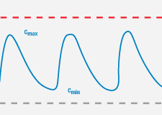

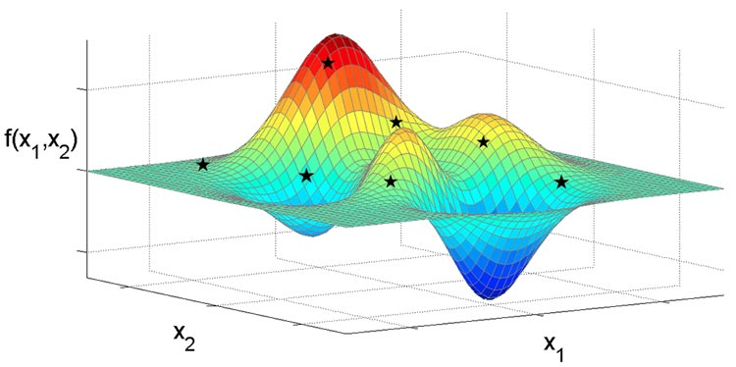


The ATOM Platform
Active Learning Drug Discovery Framework
Machine Learning Pipeline
Efficacy
Multi-Parameter Optimization Loop
Property prediction models
Systems models
Safety
Working
Compound
Library
PK
Design Criteria
Developability
Generative Molecular Design
proposes new molecules with optimized properties
Active learning decides if/when a simulation or experiment is needed to improve or validate models
Retrain property prediction models
Molecular Feature
Simulations
Simulation
Human-relevant assays, complex in vitro models
Chemistry Design & Synthesis
Experiment

Slide 4
Agenda
Why AMPL?
Open Source
Active development;
Collaborative effort;
Supporting pages;
You can bring in your own python package and use it along-side AMPL
Goal for Today
Data Ingestion + Curation
Featurization
Visualization
ML-ready datasets
ML modeling
Analysis
https://github.com/ATOMScience-org/AMPL

Slide 5
AMPL: End-to-End Data-Driven Modeling Pipeline
Common infrastructure in place and ready to receive/transform new data
Data Ingestion &
Curation
Granular Access Control
Visualization & Analysis
Train/Test/Valid ROC AUC/R²
Prediction Pipeline
Single/Batch Prediction
Splitting
Featurization
Architecture
Model Training
Python Query/Access APIs
Data Taxonomy
Web Interface
Audit trail/ versioning
Random
Scaffold
Index
Stratified
Butina Clustering
Asymmetric Validation Embedding (ATOMwise)
ECFP
MOE
Graph Convolution
Variational Autoencoder
Dragon 7
Deep Neural Network
kNN-classifier
SVM (SVC & SVR)
Native Bayes
SGD Classifier
Grid Search
Random Search
Bayesian Optimization
Genetic Optimization
k-Fold Validation
PCA, tSNE, UMAP
Model Streaming
Model Ensembling
GAN Optimization
3D Features (E3FP)
UMAP reduced features
Dataset balancing
Confusion Matrix
Uncertainty Quantification
Random Forest
AMPL provides:
Easy integration of diverse datasets
Integration with scalable data and model services environment
High-performance hyperparameter optimization
Rapid evaluation of model architecture
Seamless HPC integration using world-class compute systems
Ensemble integration of models from multiple sources
https://github.com/ATOMScience-org/AMPL
Notes:
The pipeline for training and applying predictive models is based on open source AI systems and is, in turn, being released as open source.

Slide 6
AMPL: End-to-End Data-Driven Modeling Pipeline
Common infrastructure in place and ready to receive/transform new data
Curated Smiles
COc1ccc2[nH]cc(CCNC(C)=O)c2c1
NC(=O)c1cnccn1
Clc1cccc(N2CCNCC2)c1
Nc1c2c(nc3ccccc13)CCCC2
CC(=O)Nc1ccc(O)cc1
CC(=O)Nc1nnc(S(N)(=O)=O)s1
CCCSc1ccc2nc(NC(=O)OC)[nH]c2c1
CC(C)(C)NCC(O)c1ccc(O)c(CO)c1
C=CCc1ccccc1OCC(O)CNC(C)C
CC(=O)Nc1c(I)c(NC(C)=O)c(I)c(C(=O)O)c1I
CCC1(c2ccc(N)cc2)CCC(=O)NC1=O
Train/ val/ test split
Random
Scaffold
Fingerprint
Butina
Temporal
ave_min
Featurize with ECFP or molecular descriptors:
Moe
Mordred
RDKit
ECFP
GraphConv
Model
Random forest
Neural Network
XGboost
Type
Classification
Regression
Predict
Yes/ No inhibition label
Chemical Property e.g., pIC50 value/ Ki value

Slide 7
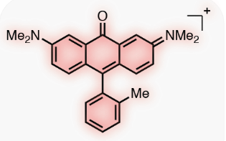
AMPL Modules
Curation
“clean” data
Splitting
Training/Validation/Test
Featurization
Model Training
Prediction
Bunch of
numbers
Remove NaN values
Average
duplicates
Remove outliers
(subjective)
• Random Forest (RF)
• Neural Network (NN)
• XGBoost
Learn to store & read in models
Use to predict on novel molecules
GMD…
• Scaffold
• Butina
• Fingerprint
• Index
• Random
• Ave_min
• Stratified
• Temporal
ecfp •
graphconv •
(?) molvae •
descriptors •
computed_descriptors •
mordred_filtered ◄
rdkit_raw ◄
moe ◄
Recommended
moe_raw ◄
moe_norm ◄
moe_filtered ◄
moe_scaled ◄
moe_scaled_filtered ◄
moe_informative ◄
More

Slide 8
AMPL Tutorial from Github https://github.com/ATOMScience-org/AMPL/tree/master/atomsci/ddm/examples/tutorials
Install AMPL (in Colab)
Data Curation using AMPL
Read data .csv files as Pandas Dataframe format
Generate a standardized SMILES, InChI keys for dataset with curation and structure modules.
# RDkit modules are used to process the SMILES strings
Visualize molecules using Rdkit
Trained & stored models
• Random Forest
• Neural Network
• XGBoost
Compare models using AMPL
Prediction on unseen new target molecules using "predict_results" returned from pfm.predict_from_model_file()
Prediction
Learn to store & read in models
Use to predict on novel molecules
• Can cause merged/created dataframes using predicted dataframe to become randomized.
• Should reset indices (reset_index(drop=True)) or use another column to merge on – compound_id, etc.
• Amanda said they thought they fixed this issue, will fix it for next release.

Slide 9
Comparing Models Trained with AMPL Slide Courtsey – Joseph Ivanic
Prediction
Tutorial 10:
Trained & stored models – Further analysis of predicted vs. actual data
shows XGBoost overfits on training set
• Random Forest
• Neural Network (best model)
• XGBoost
Learn to store & read in models
Use to predict on novel molecules
Random Forest
Neural Network
XGBoost
• Train: R² = 0.9892
• Valid: R² = 0.6682
• Test: R² = 0.7759
• Train: R² = 0.9494
• Valid: R² = 0.7926
• Test: R² = 0.8369
• Train: R² = 0.9995
• Valid: R² = 0.7587
• Test: R² = 0.7723
Actual
Predicted
Predicted
Predicted

Slide 10
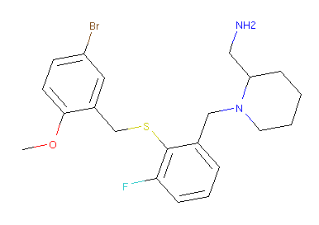
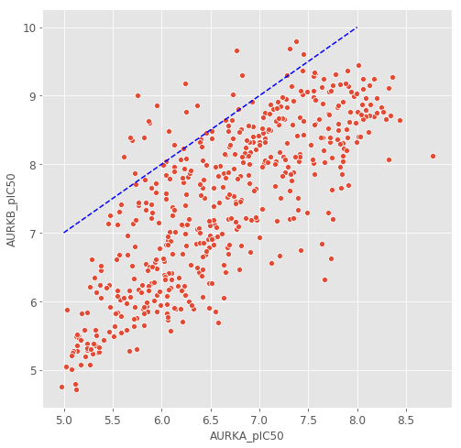
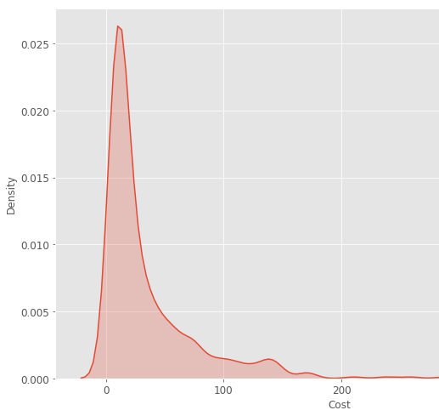
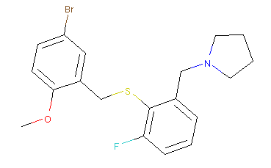
Property Prediction and Scoring
Predictions are compared against target ranges and the differences are combined using a cost function to compute a score for each molecule.
The cost function imposes penalties that are usually exponential in the deviation from the target range. The scale and weight of each cost term is adjusted according to the importance of the associated property.
We use machine learning and physics-based models to predict efficacy, safety, pharmacokinetics and developability properties for the proposed molecules.

Slide 11
Scaffold split
Mordred
MOE
ECFP
GraphConv
Neural Network (single)
Neural Network (multitask)
Random Forest
XGBoost
Number of estimators
[10, 15, 20, 25, 30, 40, 50, 60, 70, 80, 90, 100, 110, 120, 150, 200, 300, 400, 500]
Tree depth
[5, 10, 15, 20, 25, 40, 60, 80, 100, 120]
Max features per node
[16, 18, 20, 22, 24, 26, 28, 30, 32]
Gamma
[0.0, 0.05, 0.1, 0.2, 0.3, 0.4, 0.5]
Learning rate
[0.0001, 0.001, 0.01, 0.1, 0.25]
Number of layers
[1, 2, 3]
Layer sizes
[1, 2, 4, 8, 16, 32, 64, 128, 256, 512, 1024]
Learning rate
[1e-05, 5e-05, 0.0001, 0.001, 0.01, 0.025. 0.05, 0.075]
Dropouts
[0.1, 0.2, 0.3, 0.4, 0.8]

Slide 12
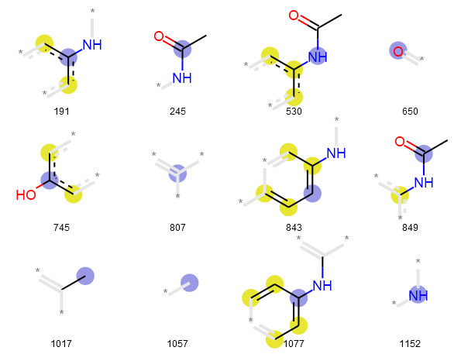
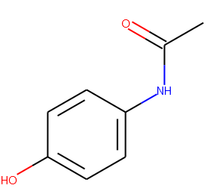
SMILES 🡪 Fingerprint
CC(=O)NC1=CC=C(C=C1)O
000000000000000000000000000000000000000000000000000000000000000000000000000000000000000000000000000000000000000000000000
000000000000000000000000000000000000000000000000000000000000000000000001000000000000000000000000000000000000000000000000
000001000000000000000000000000000000000000000000000000000000000000000000000000000000000000000000000000000000000000000000
000000000000000000000000000000000000000000000000000000000000000000000000000000000000000000000000000000000000000000000000
000000000000000000000000000000000000000000000000001000000000000000000000000000000000000000000000000000000000000000000000
000000000000000000000000000000000000000000000000001000000000000000000000000000000000000000000000000000000000000000000000
000000000000000000000000010000000000000000000000000000000000000000000000000000000000000100000000000000000000000000000000
000100000100000000000000000000000000000000000000000000000000000000000000000000000000000000000000000000000000000000000000
000000000000000000000000000000000000000000000000000000000100000000000000000000000000000000000000010000000000000000000100
000000000000000000000000000000000000000000000000000000000000000000000000100000000000000000000000000000000000000000000000
000000000000000000000000000000000000000000000000000000000000000000000000000000000000000000000000000000000000000001000000
000000000000000000000000000000000000000000000000000000000000100000000000000000000000000000000000000000000000000000000000
000000000000000000000000000000000000000000000000000000000000000000000000000000000000000000000000000000000000000000000000
000000000000000000000000000000000000000000100000000000000000000000000000000000000000000000000000000000000000000000000000
000000000000000000000000000000000000000000000000000000000000000000000010000000000000000000000000001000000000000000000000
000000000000000010000000000000000000000000000000000000000000000000000000010000000000000000000000000000000000000000000100
000000000000000000000000000000000000000000000000000000000000000000000000000000000000000000000000000000000000000000000000
00000000
Paracetamol
https://github.com/ravichas/ML-predict-drugclass (additional information on Fingerprints)

Slide 13
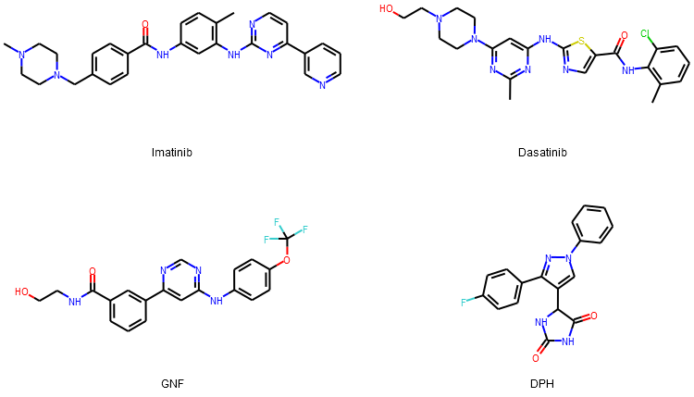
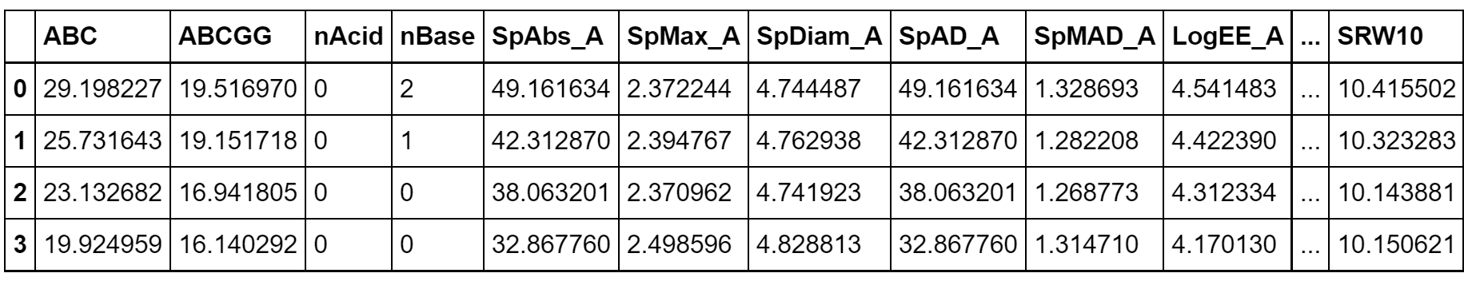
Featurizing a molecule: Molecular descriptors
Physicochemical properties
Molecular weight, # of Hydrogen bond donors, log partition coefficient etc.
Mordred
~1800 descriptors
Open source software
Implemented in AMPL
https://mordred-descriptor.github.io/documentation/master/descriptors.html

Slide 14


Computing Env
This Photo by Unknown Author is licensed under CC BY-SA-NC
COLAB | NIH HPC Biowulf
Serverless | Can ask for resources
Resources are !unlimited and !guaranteed | Resources are guaranteed
Browser-based | Mostly command-line
Good for short jobs; explaining AMPL capabilities | Long jobs (HPO)
Audience: Interns, Workshop attendee (Educational) | Research

Slide 15
Useful links
https://github.com/ATOMconsortium/AMPL
https://github.com/ATOMconsortium/AMPL/tree/Tutorials/atomsci/ddm/examples/tutorials
https://hpc.nih.gov/apps/ampl.html
Workshop materials
https://github.com/ravichas/AMPL-Tutorial (Look for “Workshops” to find the Notebook)
https://github.com/ravichas/AMPL-workshop-1 (optional)

Slide 16
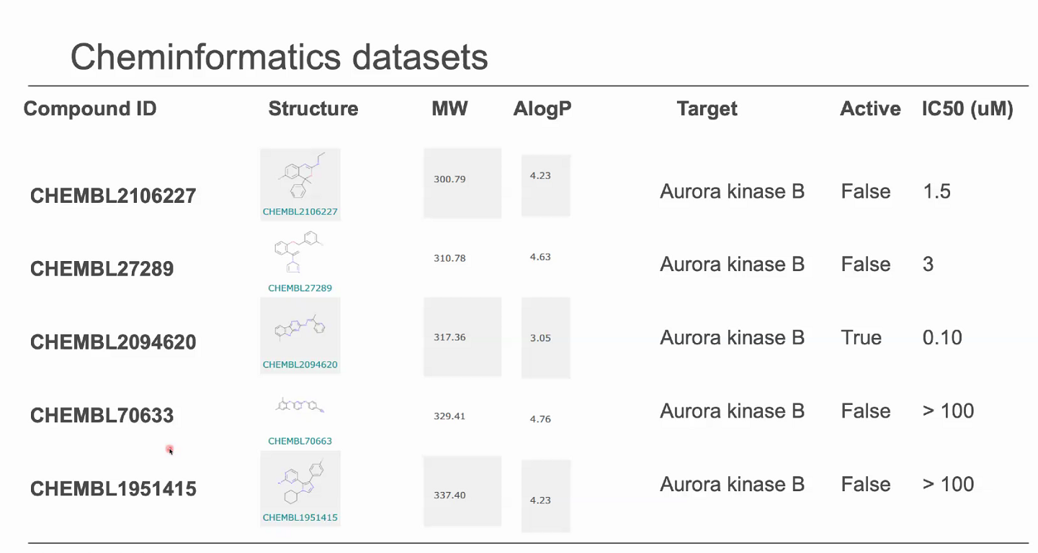
A sample dataset

Slide 17
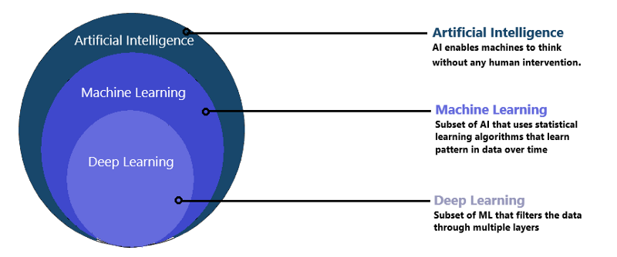
The ATOM Platform

Slide 18
